Slide 1
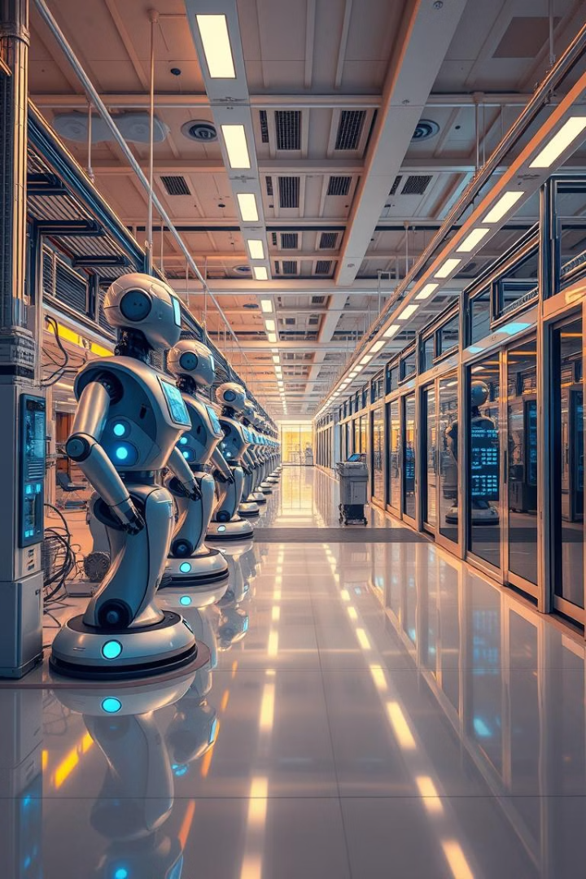


Manufacturing's Future: Using AI and Machine Learning to Help OEMs
AI and machine learning are transforming the manufacturing landscape, enabling Original Equipment Manufacturers (OEMs) to optimize operations, enhance efficiency, and gain a competitive edge.

Slide 2

Challenges facing OEMs in the modern manufacturing landscape
1
Rising Costs
2
Intensified Competition
Material costs, labor shortages, and energy prices are increasing, putting pressure on profit margins.
Globalization and technological advancements are driving intense competition in the manufacturing sector.
3
Supply Chain Disruptions
4
Demand Fluctuations
Global events, such as pandemics and natural disasters, can disrupt supply chains, leading to delays and production disruptions.
Unpredictable demand patterns make it challenging for OEMs to manage inventory levels and optimize production schedules.

Slide 3
How AI and machine learning can optimize operations
Predictive Maintenance
Quality Control
Process Optimization
AI algorithms can analyze sensor data to predict equipment failures, preventing downtime and reducing maintenance costs.
Machine vision systems can detect defects in products, ensuring quality and reducing the number of faulty items.
AI can analyze production data to identify bottlenecks and inefficiencies, leading to streamlined operations and improved productivity.

Slide 4
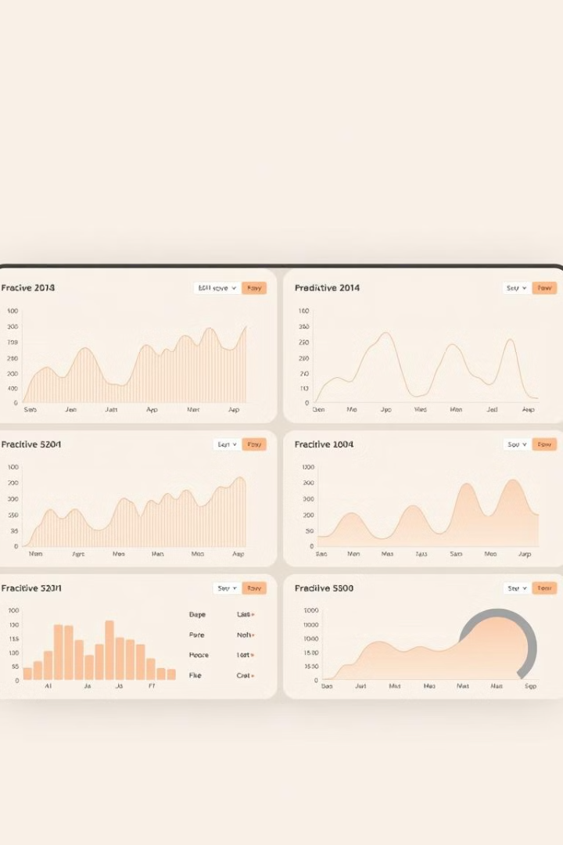
Prototype solution: AI-powered predictive maintenance system
Sensor Integration
Data Analysis
The system integrates with existing sensors on equipment to collect real-time data on performance, temperature, vibration, and other key parameters.
AI algorithms analyze sensor data to identify patterns and anomalies, predicting potential equipment failures before they occur.
Alert System
The system generates alerts to maintenance teams, providing timely notifications about potential issues and allowing for proactive maintenance scheduling.

Slide 5
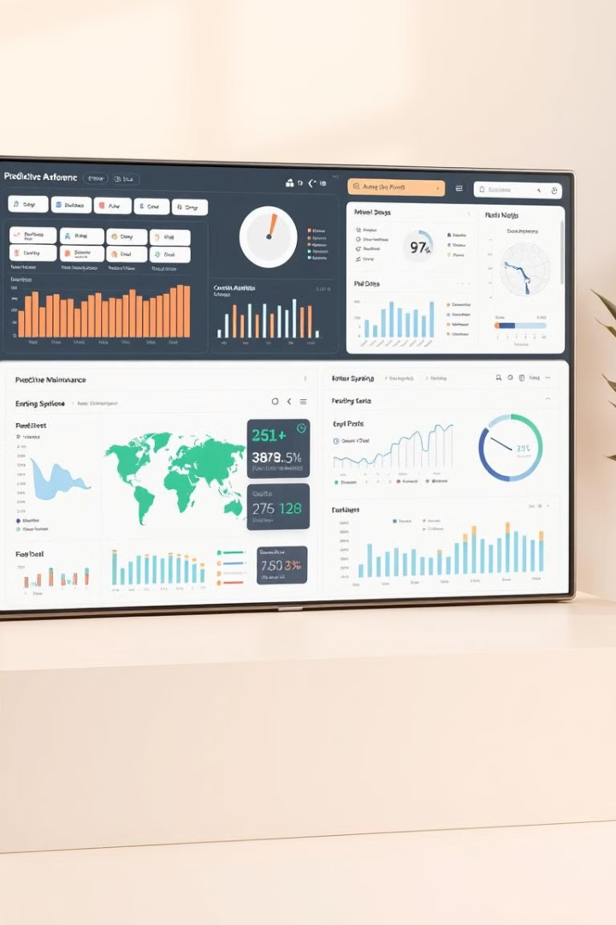



Key features and capabilities of the predictive maintenance system
Real-time Monitoring
The system provides continuous monitoring of equipment performance, enabling operators to identify and address potential issues quickly.
Predictive Analytics
AI algorithms analyze data to predict equipment failures with high accuracy, allowing for proactive maintenance planning.
Automated Reporting
The system generates detailed reports on equipment health, maintenance history, and performance trends, providing valuable insights for decision-making.

Slide 6

Real-world case studies and results
Case Study
Improved Uptime
Reduced Maintenance Costs
Auto Manufacturing Plant
10%
15%
Aerospace Component Manufacturer
8%
12%
Pharmaceutical Production Facility
9%
14%

Slide 7

Integrating the solution with existing manufacturing infrastructure
1
Data Collection
Collecting data from existing sensors and systems.
2
System Configuration
Configuring the predictive maintenance system to match the specific needs of the manufacturing facility.
3
Training and Deployment
Training AI algorithms on historical data and deploying the system for real-time monitoring and predictive analytics.
4
Ongoing Monitoring and Optimization
Continuously monitoring system performance, fine-tuning AI models, and adapting the system to evolving needs.

Slide 8
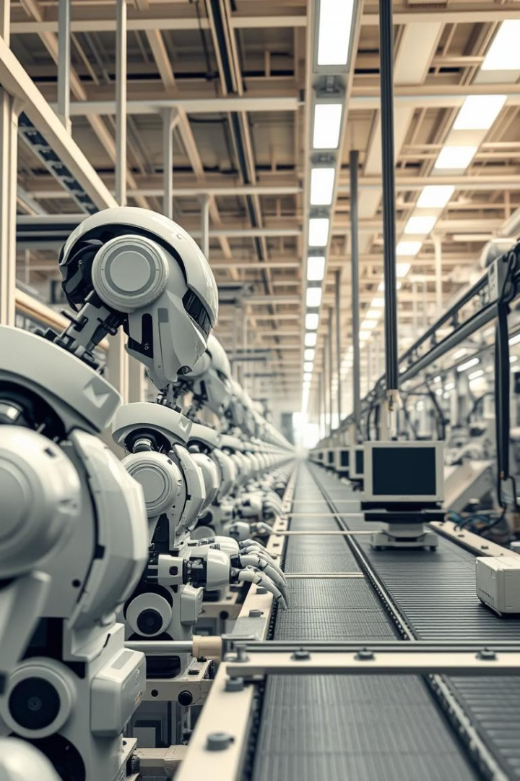




Conclusion and next steps for embracing AI in manufacturing
Automation
Data Analytics
Embrace automation and AI to streamline processes and improve efficiency.
Leverage data analytics to gain insights and make data-driven decisions.
Innovation
Collaboration
Stay at the forefront of innovation by exploring new AI technologies and applications.
Partner with AI experts and technology providers to implement AI solutions effectively.

